Slide 1
CRUNCHING THE CHIPS: Data Analytics For The Retail Stores
June 2020
QUANTIUM DATA ANALYTICS VIRTUAL INTENSHIP PROGRAM(Forage) - 2023
Done By,
Data Analyst : SETHU S
thumbnail > Layout > Title

Slide 2

AGENDA
Introduction
Data Collection
Task1: Data Visualization
Task 2: Statistical Analysis
* Correlation Analysis
* Two way Anova
* Independent t-Test
Key Findings
Suggestion
Conclusion
Notes:
To view Privacy video explaining how important data privacy is to Quantium, please click here: https://www.youtube.com/watch?v=Zq1QDAkoRzU
or here Q:\Company Reference\Brand & Design\Brand videos\Q Privacy.mp4
At Quantium, we believe that data is the behavioural footprint of humanity and that it has to be treated with the utmost care and responsibility.
Histories, attitudes, indeed lives are stored within it in ways that aren’t always apparent – and that’s what makes its potential so powerful.
To work with it responsibly, sensitively, we set ourselves the highest data privacy protection and governance standards.
We have spent 17 years perfecting privacy-by-design and secure-by-design principles. Central to this is not holding any personally identifiable information about people –
we neither receive it, and put the necessary protections in place to be unable to decipher it.
Every aspect of handling data is safeguarded: from its de-identification, to its encryption – data security is paramount and of the highest grade.
We pride ourselves on gaining the trust of iconic organisations around the world through years of securely working with their data,
and in turn the trust that builds with their stakeholders.

Slide 3

Data Collection
Quantium has had a data partnership with a large supermarket brand for the last few years who provide transactional and customer data.
Supermarkets will regularly change their store layouts, product selections, prices and promotions.
This is to satisfy their customer’s changing needs and preferences, keep up with the increasing competition in the market or to capitalise on new opportunities.
GOAL: Quantium analytics team are engaged in these processes to evaluate and analyse the performance of change and recommend whether it has been successful.
Notes:
To view Privacy video explaining how important data privacy is to Quantium, please click here: https://www.youtube.com/watch?v=Zq1QDAkoRzU
or here Q:\Company Reference\Brand & Design\Brand videos\Q Privacy.mp4
At Quantium, we believe that data is the behavioural footprint of humanity and that it has to be treated with the utmost care and responsibility.
Histories, attitudes, indeed lives are stored within it in ways that aren’t always apparent – and that’s what makes its potential so powerful.
To work with it responsibly, sensitively, we set ourselves the highest data privacy protection and governance standards.
We have spent 17 years perfecting privacy-by-design and secure-by-design principles. Central to this is not holding any personally identifiable information about people –
we neither receive it, and put the necessary protections in place to be unable to decipher it.
Every aspect of handling data is safeguarded: from its de-identification, to its encryption – data security is paramount and of the highest grade.
We pride ourselves on gaining the trust of iconic organisations around the world through years of securely working with their data,
and in turn the trust that builds with their stakeholders.

Slide 4

01
Executive summary
Task 1
In the Task 1, our Analytics team worked on the two csv files and merged both files into single files using STORE NO’s.
Data Wrangling has implemented.
Outliers are removed by using the z score statistical method.
Analytics Team worked on Data Visualization to dig out the intuitive key finding based on the dataset provided by the Stakeholders Retail Stores.
In the Task 2, our Analytics team worked on the Retail Stores and splitted into two types. And they are: Control Stores and Trial Stores.
The Control Stores are the one which is left under its own conditions and performance without any intreset.
Two way Anova have been implemented to find out any interactions effect are actually hidden within the given features of the dataset.
Pearson Correlation Analysis done on the Total sales
Independent samples t-test was used to find the mean of Total sales of same in performance or not.
02
Task 2

Slide 5
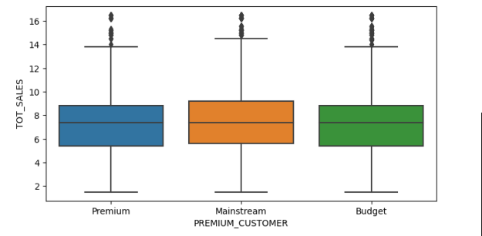
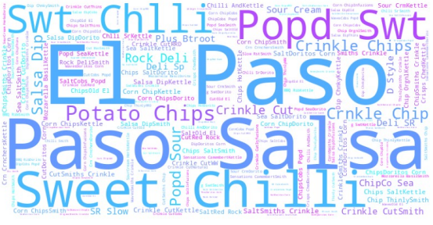
TASK 1: DATA VISUALIZATION
Based on the Total sales the Premium Customer Segmentaion categories such as Premium, Mainstream and
Budget have the similar spread from the dataset
Top Brands are :
Paso Sasla
El Paso
Sweet Chili
Popd Sweet

Slide 6
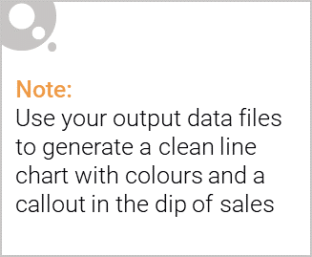
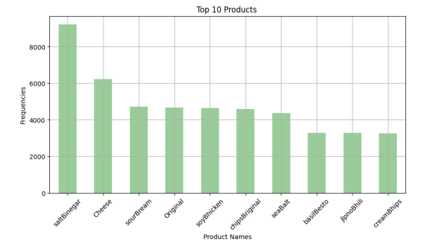
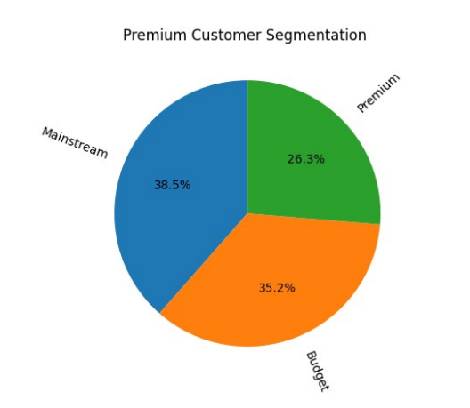
Top 3 Product:
SaltVinegar
Cheese
SourCream
Premium Customer Segmentaion :
MainStream
Budget
Premium

Slide 7
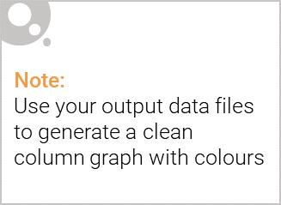
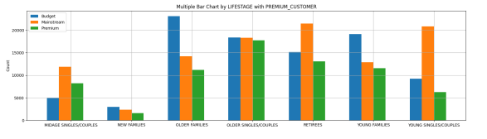
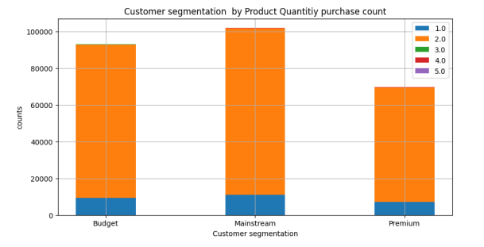
LifeStage Top Population Based On Premium Customer Segmentation:
Older Families prefers Budget.
Retirees and Young couples/Singles are more or less equal for preferring Mainstream.
Older Singles/Couples are top most for preferring Premium category.
Product Quantity Prefences:
All the 3 categories purchases 2 as most among other Product quantities.
Prd Qty: 3,4,5 are comparatively too less preferred.

Slide 8
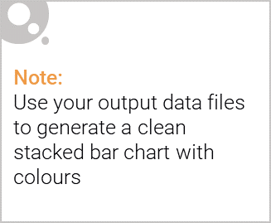
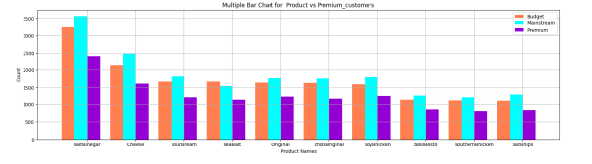
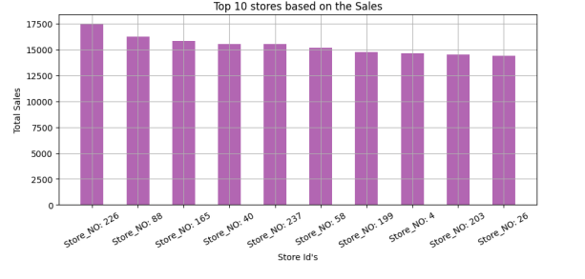
Editable (delete this)
Premium Customer Preference On Products:
SaltVinegar is top on all the categories
SouthernChicken is less preferred by population Premium category.
Top Retail Stores Based On Total Sales:
Store no: 226
Store no: 88
Store no: 165

Slide 9
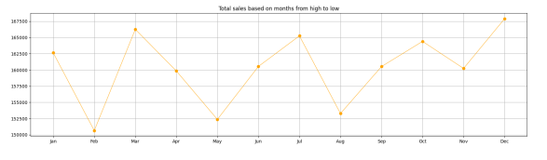
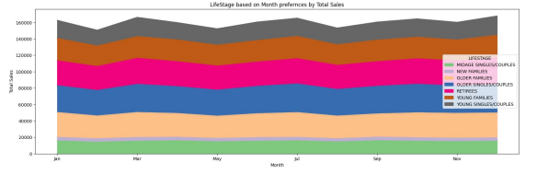
Editable (delete this)
Total Sales Over Months:
December 2018 was the 1st highest for Total Sales
March 2019 was the 2nd highest on Total Sales
February 2019 was the lowest on Total Sales
Population On The Total Sales:
Young Single/Couples are at the top position.
Young Families are at the 2nd position.
Retirees are at the 3rd position.
Middle age Singles and Couples are the lowest position.

Slide 10
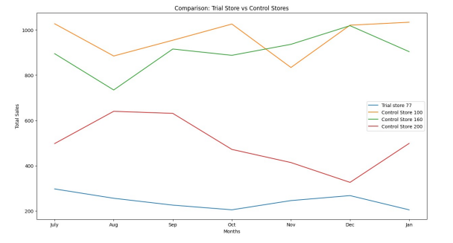
TASK 2: COMPARISON: TRIAL STORE VS CONTROL STORES
TASK 2: COMPARISON: TRIAL STORE VS CONTROL STORES
Control Stores: These Stores are actually not under any criteria to satisfy ,does not receives any control over its performances and wont get any special treatments. STORE : 100, 160,200.
Trial Stores: These Stores will actually gets more attention because it will be receiving some treatments and special attention to boost up its perfomances on Total Sales. STORE:77, 86 and 88.
CORRELATION ANALYSIS:
Control Store 100 and 160 performed well when comparing with Trial Store 77.
But there is no Significant correlation found between these Stores in terms of Total Sales.

Slide 11
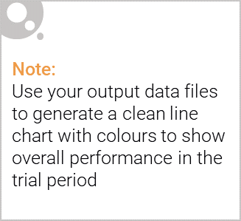
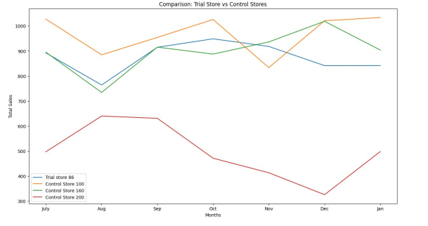
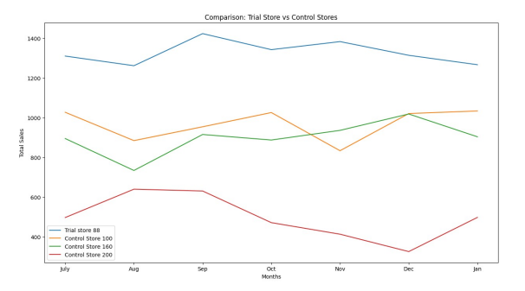
Control Store 100 and 160 performed well than Trial store 86 in Total sales.
But there is no Significant correlation found between these Stores in terms of Total Sales.
Trial store 88 performed well than the Control Stores 100 and 160 in Total sales.
But there is no Significant correlation found between these Stores in terms of Total Sales.

Slide 12

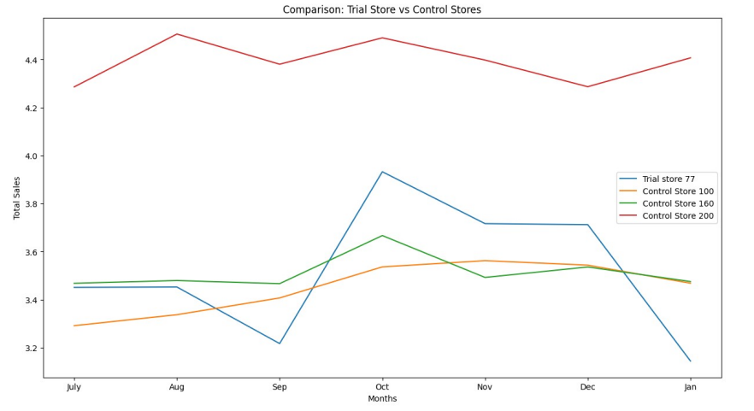
Control Store 200 performed well than other Stores in Avg Price/ Unit.
But there is Significantly Strong Positive correlation(uphill trend) found between these Control Store: 160 and in terms of Avg Price/ Unit.

Slide 13
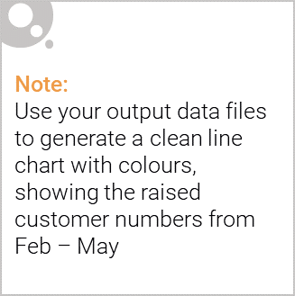
TWO WAY ANOVA FINDINGS :
Features That Have Significant Effect On Total Sales And Those Categories Are:
Premium customers
Product Quantity
Life Stage
Significant Interacion Effect On Total Sales Are:
Premium customers : Life Stage
Product Quantity : Life Stage
INDEPENDENT SAMPLE T-TEST:
Significant Differences Observed On Control Store and Trial Stores on Total Sales:
Control Store: 100,200 vs Trial Store: 77
Control Store: 100,200 vs Trial Store: 78
Control Store: 200 vs Trial Store: 80
Significant Differences Observed On Control Store and Trial Stores on [Average Transaction / Customer]:
Control Store: 200 vs Trial Store: 86
Control Store: 200 vs Trial Store: 88

Slide 14

Conclusion:
People preferring more Salt Vinegar , Cheese and some other products more.
Mainstream preferring population is more in Premium Customer Segmentation.
Among Life Stages of people Older Singles and couples are the larger one.
New Families should be targeted because they are too less in Premium Customer Segmentation.(on Budget, Mainstream and Premium).
Salt Vinegar is mostly preferred by Mainstream population.
Premium Customer are less preferred on BasilBesto.
Top Total Sales was currently holding by Store: 226.
Total Sales Peaked at December 2018.
In Product quantity is most preferred is 2 by the current population.
NOTE:
Additional Concentration Is need on Trial Stores based on Total Sales and no significant Correlation founded between them.
A Strong positive correlation found between Trial Store:77 and Control Store: 160 on Avg Price/ Unit.
THANK YOU!

